Slide 1




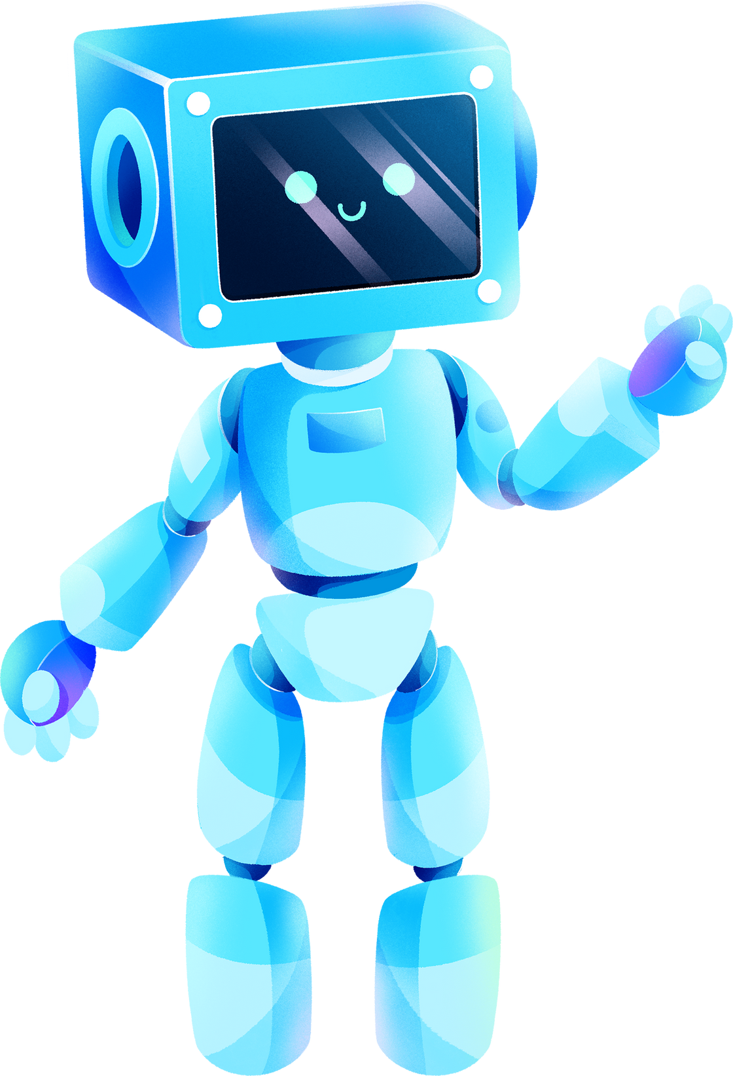

ROBOT FRAMEWORK
BY ANISH KUMAR

Slide 2
TABLE OF CONTENTS
1. Introduction to Robot Framework
Brief overview of Robot Framework
Key Feature of Robot framework
2. Installation of Robot Framework
Prerequisites for installation
Step-by-step installation guide
3. Project Objectives
Goals and expected outcomes of the project
Importance of using Robot Framework in achieving these objectives
4. Setting Up the Application on Localhost
Instructions for setting up the development environment
Configuration steps to run the application locally
5. Explaining the Test Cases
Overview of the test strategy and structure
Detailed explanation of key test cases, including objectives and expected results

Slide 3
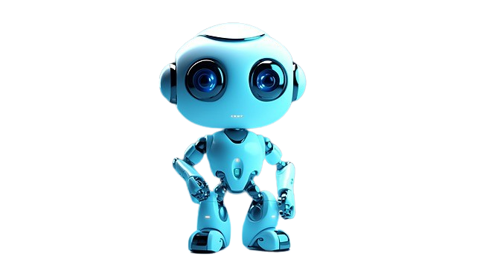
INTRODUCTION
Robot Framework is an open-source automation testing framework that provides a generic approach to acceptance testing, acceptance test-driven development (ATDD), and robotic process automation (RPA).
Key Feture of Robot Framework
Keyword-Driven Approach: Allows for creating tests using high-level keywords, enhancing readability and maintainability.
Platform Independence: Runs on Python, with support for Java (Jython) and .NET (IronPython) environments.
Extensive Library Support: Comes with built-in libraries and a vast collection of external libraries for various testing needs (e.g., web, API, database).
Tabular Test Data Syntax: Facilitates easy creation and understanding of test cases in a tabular format.
Rich Reporting: Generates detailed logs and reports, providing clear insights into test execution and outcomes.

Slide 4
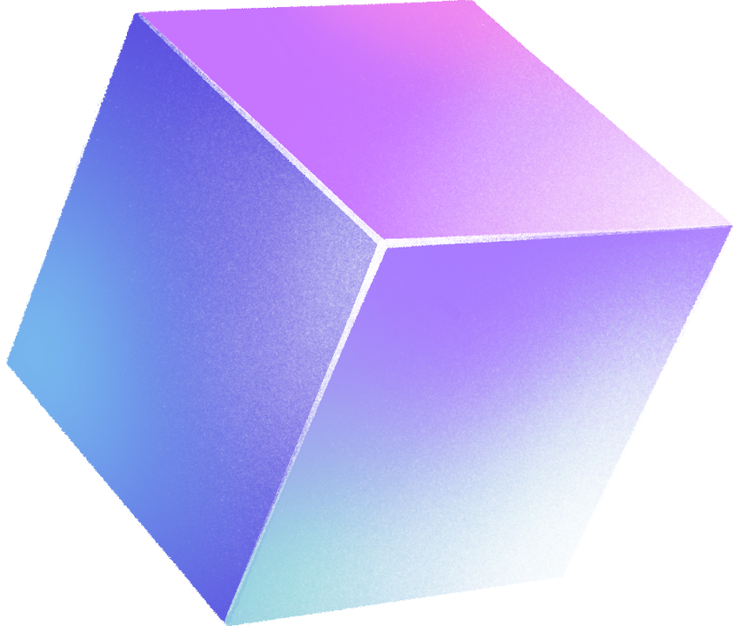
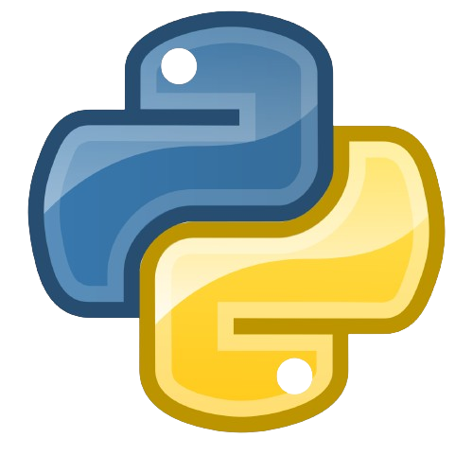

PREREQUISITES FOR INSTALLATION OF ROBOT FRAMEWORK
Python Installation
Install Python 3.x, as it's required to run Robot Framework. Python 2 is not recommended as it has reached its end of life.
Make sure to add Python to your system's PATH during installation.
Download Python from the official Python website.
pip (Python Package Installer):
pip is used to install Robot Framework and its dependencies. It's usually included with your Python installation.
Verify pip installation by running pip --version in your command line or terminal. If it's not installed, follow the installation guide on the official pip website.
WebDriver (For Web Testing):
If automating web browsers, ensure to have the correct WebDriver for each browser. For example, Chrome requires ChromeDriver, and Firefox needs GeckoDriver.
WebDrivers should be placed in a directory included in your system’s PATH, or their location can be specified in your tests.
With Python and pip installed, you can install Robot Framework using the following pip command: pip install robotframework.

Slide 5
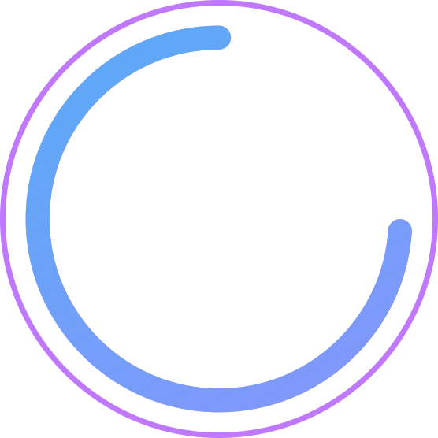
GOALS AND EXPECTED OUTCOMES OF THE PROJECT
01
02
03
04
I've created a framework for banking applications; this session will help you easily create a framework and automate various types of applications
I've integrated this framework with Gmail; understanding it allows for easy integration with any messaging service like Slack, Gmail, Microsoft Teams, or Jira.
I've integrated this framework with Jenkins for CI/CD. Grasping its entirety enables integration with various CI/CD tools, such as GitHub Actions, Jenkins, CircleCI.
I've also utilized Docker for running project images in Docker containers, and it's possible to integrate Jenkins with Docker. This can be highly beneficial for you.

Slide 6

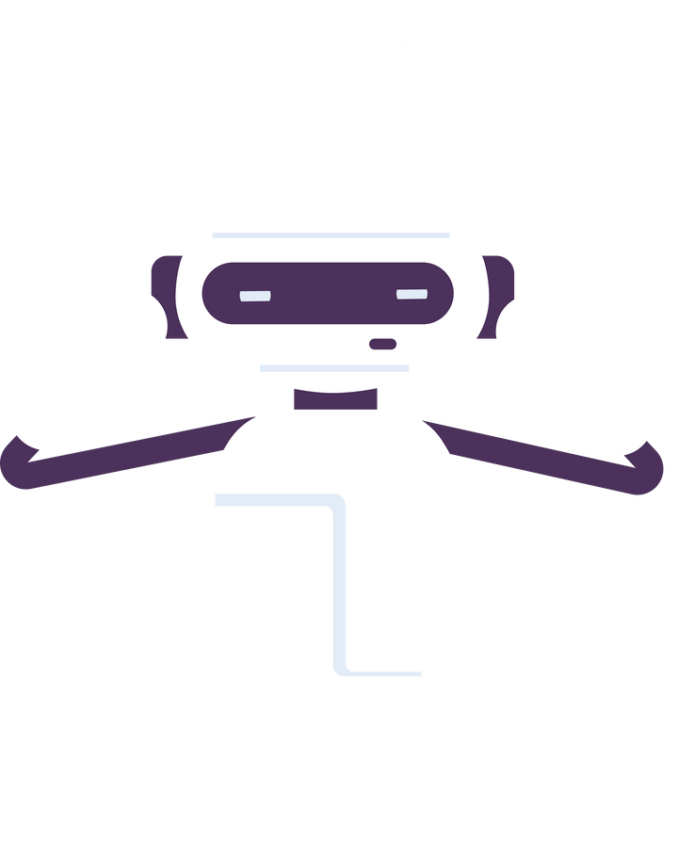
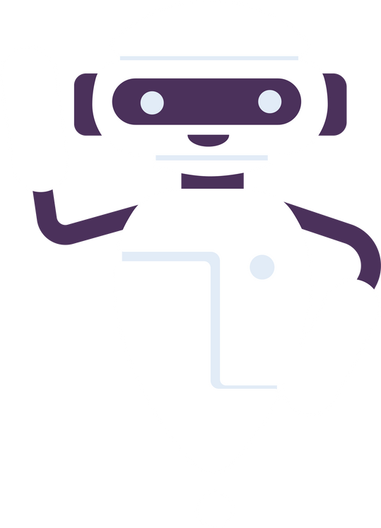
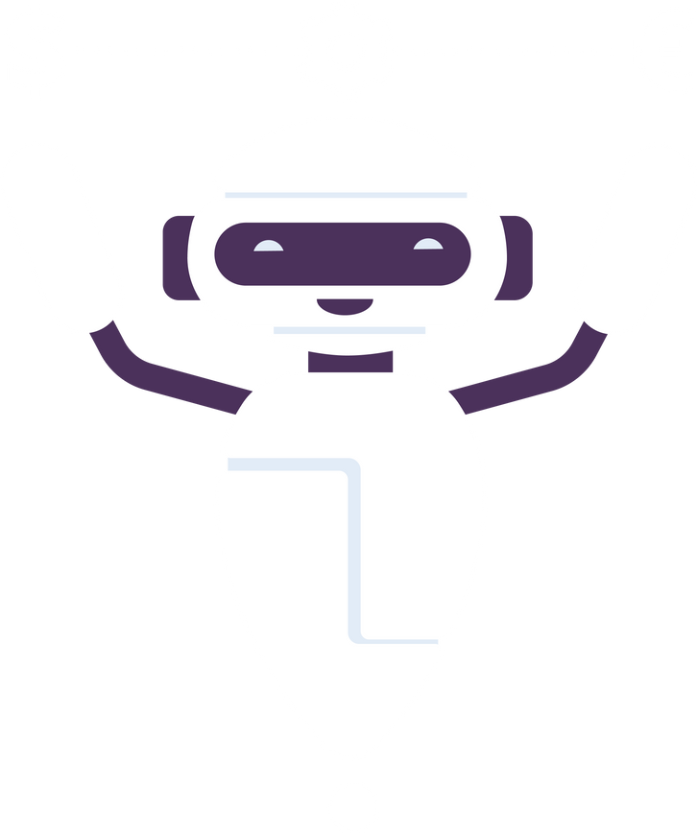

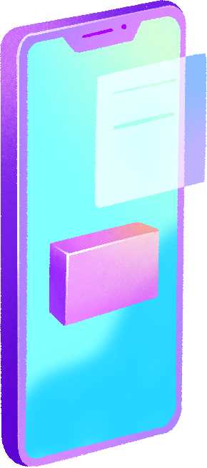

FRAMEWORK FOLDER STRUCTURE
PAGEOBJECT
KEYWORD
TEST
GMAIL CONFIG
In the PageObject folder, I've created files for every page I wanted to automate, storing each page's locators and other page objects.
In the Keywords folder, I have created multiple Robot Framework files, each defining keywords for interacting with page elements and performing assertions.
In the Test folder, I've created a test file for each page and written scripts to validate the functionality.
In the Gmail Configuration folder, I've created two files: the first is a Python file containing code for sending emails, and the second is a Robot Framework file where I've defined keywords for email sending.m dolor vel est fermentum, at sagittis diam.

Slide 7
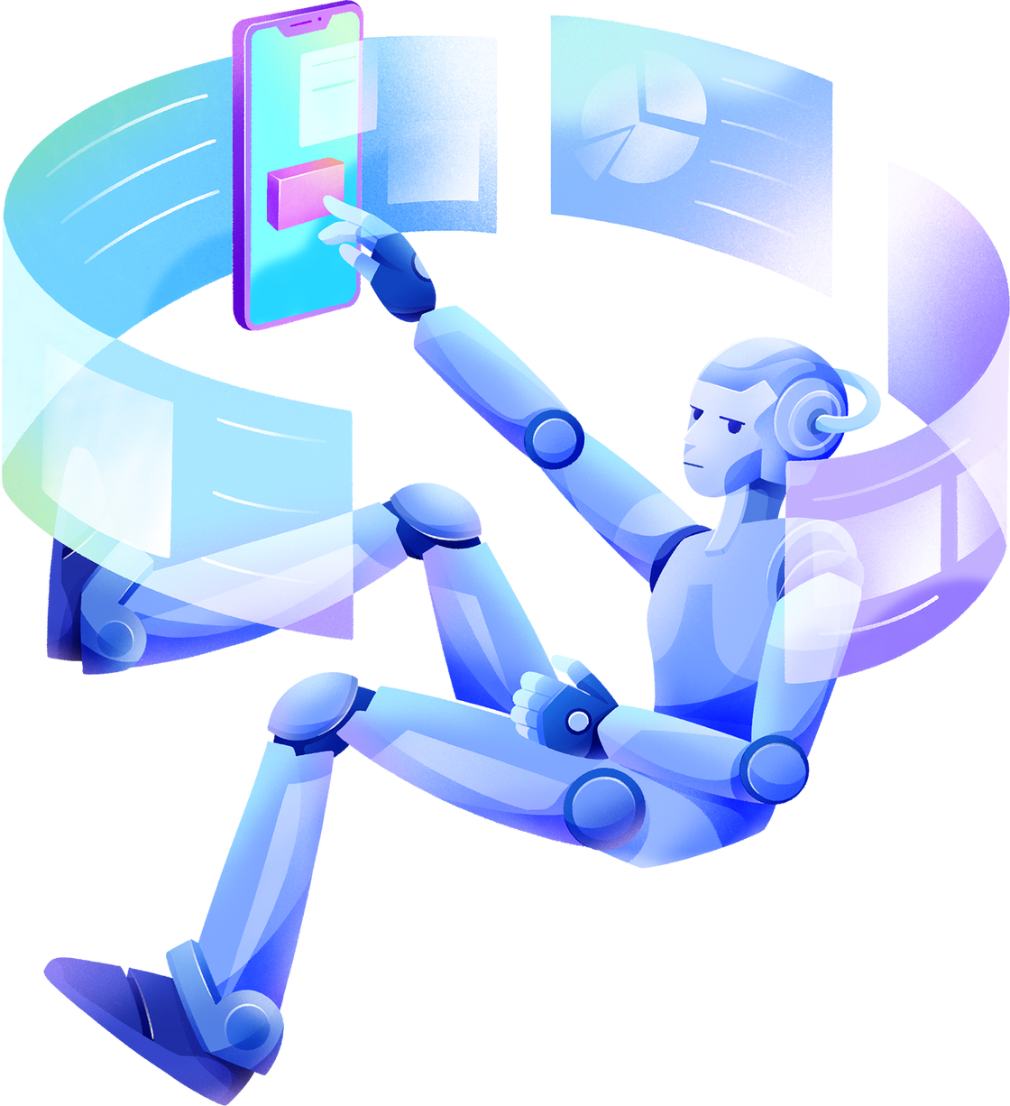

PROJECT SETUP

Slide 8



DOWNLOAD AND INSTALL XAMPP:
Visit the Apache Friends website and download the XAMPP installer for your operating system (Windows, Linux, or MacOS).
Run the installer. During installation, you can choose which components to install. For a basic setup, Apache, MySQL, and PHP are essential.
Follow the on-screen instructions to complete the installation.
START THE APACHE AND MYSQL SERVICES:CY
Open the XAMPP Control Panel, which you can find in your Start Menu or Applications folder, depending on your OS.
Start the Apache and MySQL modules by clicking the 'Start' buttons next to each service.
, at sagittis diam.
CREATE A PROJECT DIRECTORY:
Navigate to the htdocs directory in your XAMPP installation folder. By default, this is C:\xampp\htdocs on Windows, or /Applications/XAMPP/htdocs on MacOS.
Create a new directory for your project within htdocs. This directory name will be used in the URL to access your project.
agittis diam.

Slide 9
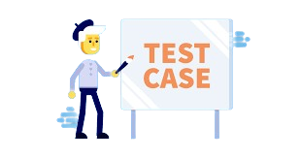

UI TESTCASES AND API TESTCASES
I've created 21 functional test cases for validating the UI functionality of the banking application and written ten API test cases. In total, this framework includes around 31 test cases. I am providing a link to the test case document for further inspection if you're interested.

Slide 10
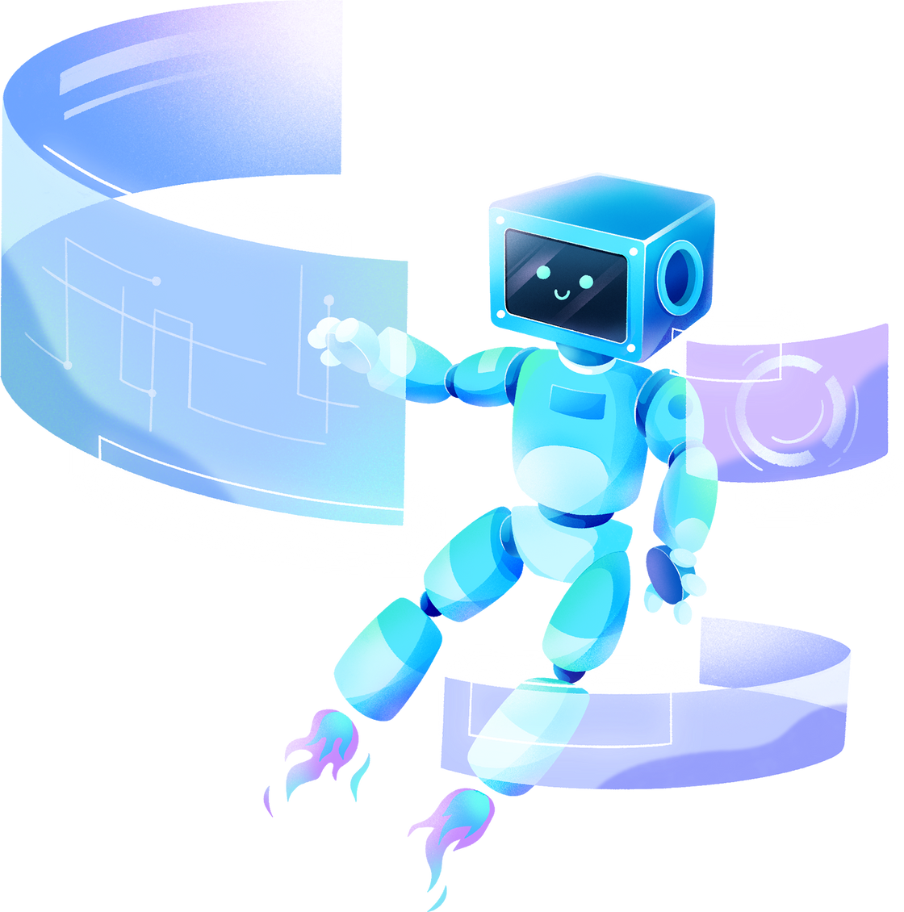
THANK YOU!

